Slide 1
Generation of Empirical Tight Binding Parameters from ab-initio simulations
Yaohua Tan, Michael Povolotskyi, Tillmann Kubis, Timothy B. Boykin* and Gerhard Klimeck
Network for Computational Nanotechnology, Purdue University
*Department of Electrical and computer Engineering, University of Alabama in Huntsville

Slide 2
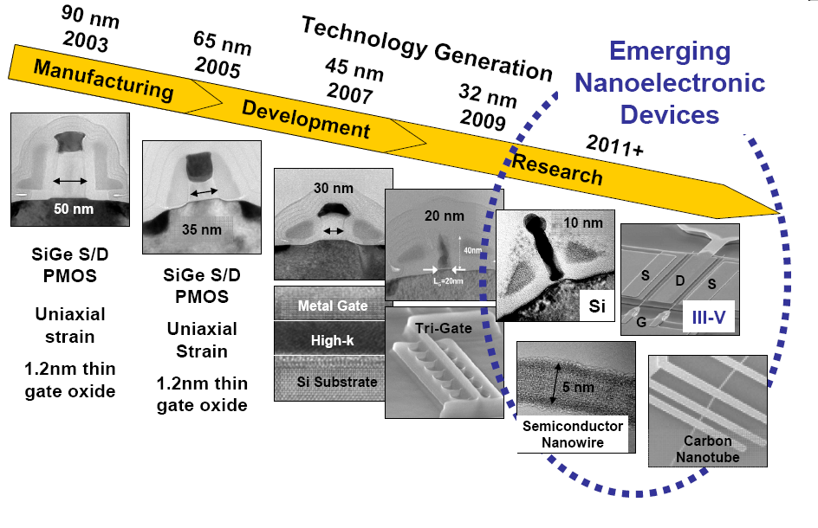
Motivation
Nano electronic devices
complicated 2D/3D geometries;
10000 ~ 10 million atoms in the active domain;
many materials are used.
Candidate methods for device-level simulations
Ab-initio methods
Empirical methods
→ efficiency should be considered

Slide 3
simulation time and accuracy
Empirical Tight Binding
can be fast and accurate enough
→ Easier for device level calculations
LDA /GGA
sp3s* TB
Empirical TB
ab-initio methods
Error
(compared with Experiment)
GW/BSE
sp3d5s* TB
Depend on
parameters
Device-level calculations are possible
Simulation time

Slide 4
Brief summary: empirical TB vs ab-initio methods
 | Empirical TB | Ab-initio methods
Computation load | light | heavy
Application to quantum transport | Widely used | demonstrated by some works.
Parameterization | Empirical | Non-empirical
Explicit basis functions | No | Yes
TB parameters of commonly used semiconductors are obtained.
J. Jancu, et al., PRB 57 6493
T. Boykin, et al., PRB 66 125207
Issue: How to get TB parameters for new materials?

Slide 5
How to get TB parameters for new materials?
Traditional way:
This work:
By fitting to experimental band structures.
Demonstrated working for many situations
Ab-initio calculations
+ TB parameters construction
Advantage:
less empirical;
can get TB Basis functions.
Disadvantage:
Dependent on ab-initio calculations.
Disadvantage: (for exotic materials)
insufficient experimental data;
TB basis remains unknown.
Require reliable ab-initio calculations;
GW / hybrid functional / bandgap correction;
J. Jancu, etc, PRB 57 6493
T. Boykin, etc, PRB 66 125207

Slide 6
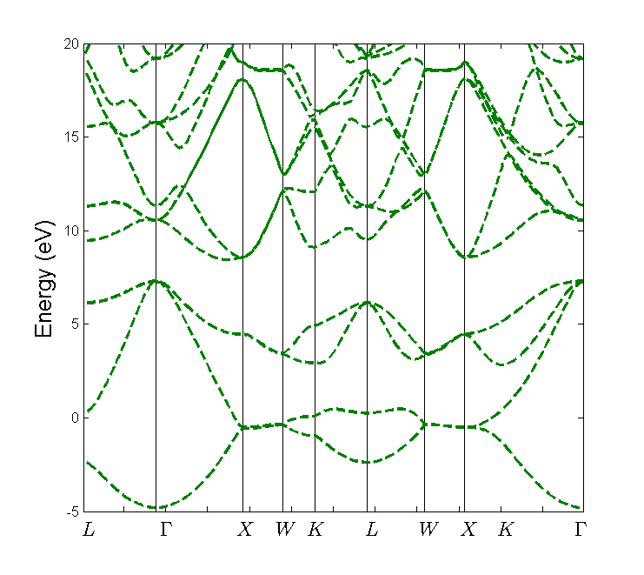
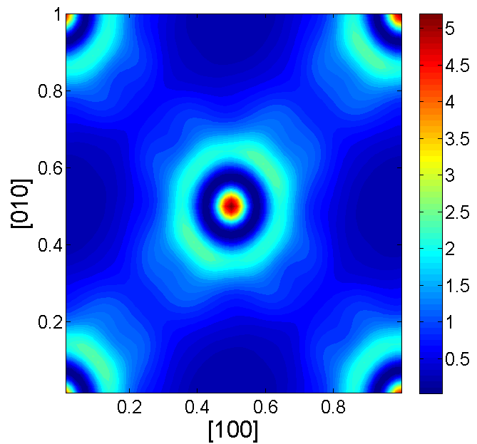
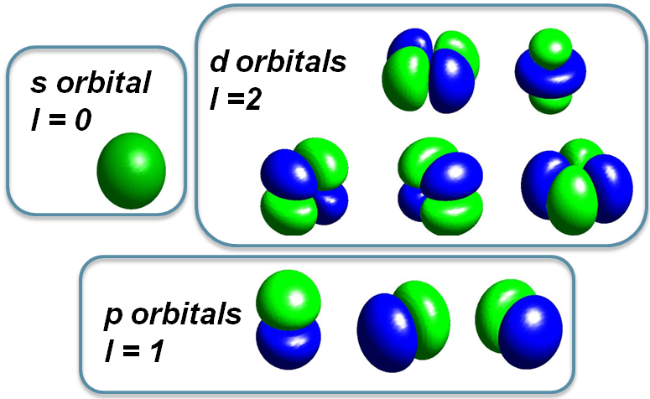
Method
Y_{l,m}(θ,ϕ)
Step: ab-initio calculation → E_{i}(k), φ_{i,k}(r), H_{ab-initio}
Ab-initio band structure E_{i}(k)
2. Step: Define analytical formula for TB basis functions Ψ_{n,l,m} (r,θ,ϕ) = R_{n,l}(r)Y_{l,m}(θ,ϕ) Y_{l,m}(θ,ϕ) is Tesseral function, R_{n,l}(r) is to be parametrized
Wave functions φ_{i,k}(r)

Slide 7
Method (continue)
Step: Parameterize R_{n,l}(r)
get transform matrix U: ab-initio basis → TB basisΨ_{n,l,m}
4. Step:
basis transformation (low rank approximation):
H_{ab-initio} → H_{TB}
Approximate H_{TB} by two center integrals;
Iteratively optimize the TB results
Step:
Compare the TB results (band structure, wave functions) to ab-initio results; Measure the overlaps of basis functions;
J. Slater & G.Koster PR. 94,1498(1964)
A. Podolskiy & P. Vogl PRB 69, 233101 (2004)

Slide 8
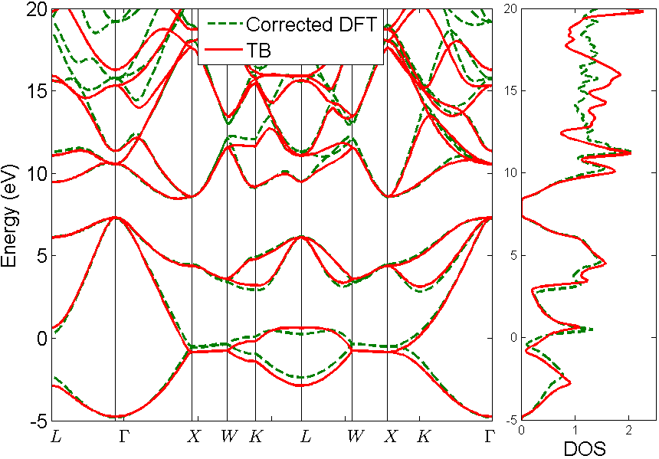
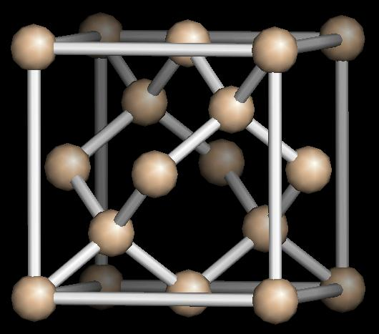
Band structure of Silicon
The Silicon is parameterized using 1st nearest neighbor sp3d5s* model.
Most of the important bands agree with the DFT result!
ABINIT is used to perform the DFT calculations
Band gap is corrected by applying scissor operator

Slide 9
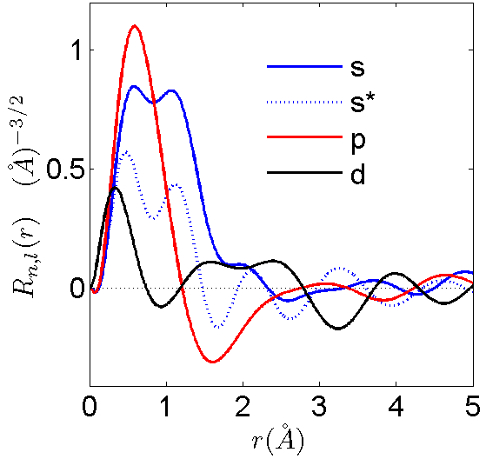
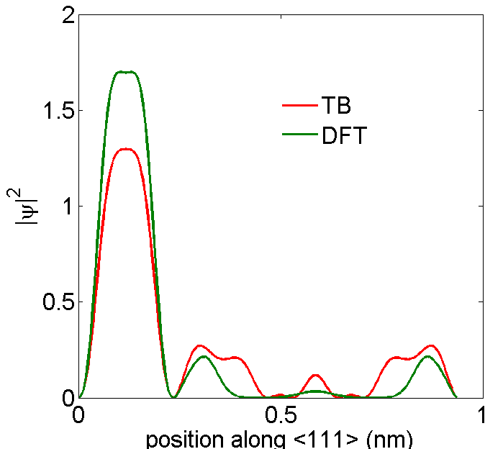
Basis functions and wave functions of Silicon
Radial parts of TB Basis functions
Real space WFs of top most valence bands
High probability → Si-Si bond
Si
Si
Si
TB Basis functions are obtained;
Selected TB eigen states are fitted to the corresponding DFT eigen states.
Properties beyond traditional Empirical TB

Slide 10
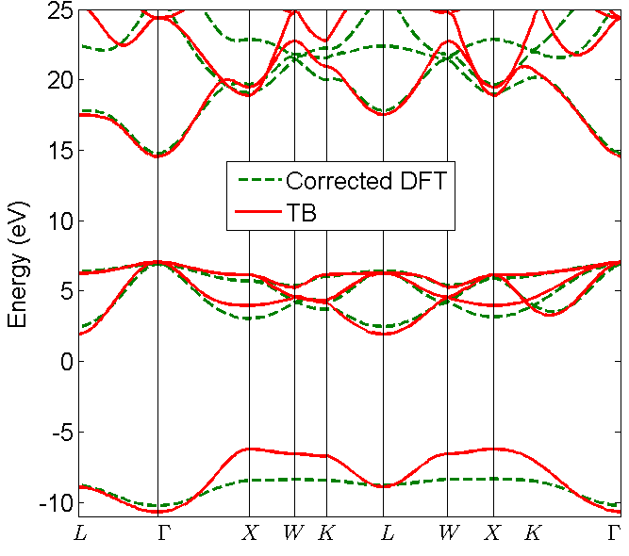
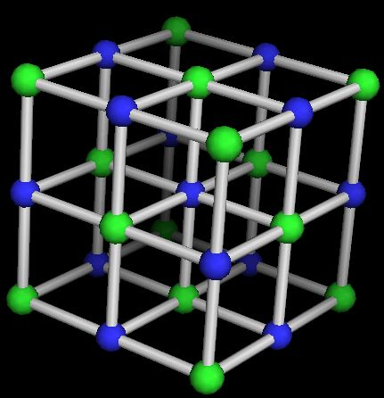
band structure of bulk MgO
Application to new material MgO.
(No existing reasonable parameters.)
sp3d5s* model with 2nd NNs coupling is used
Most of the important bands agree with the DFT result!

Slide 11
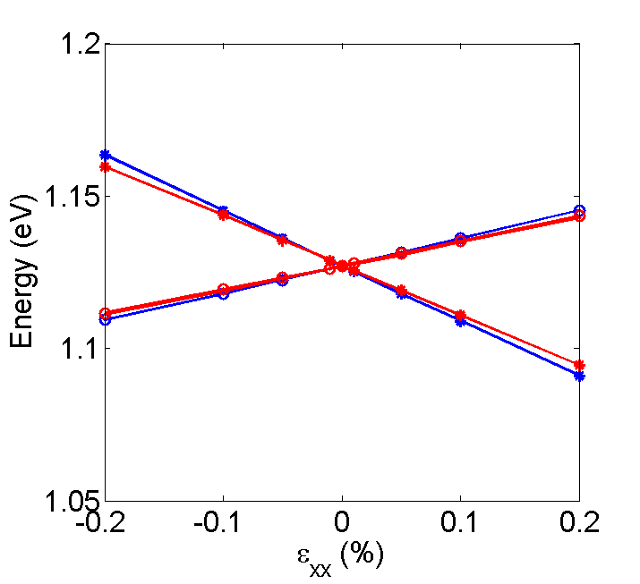
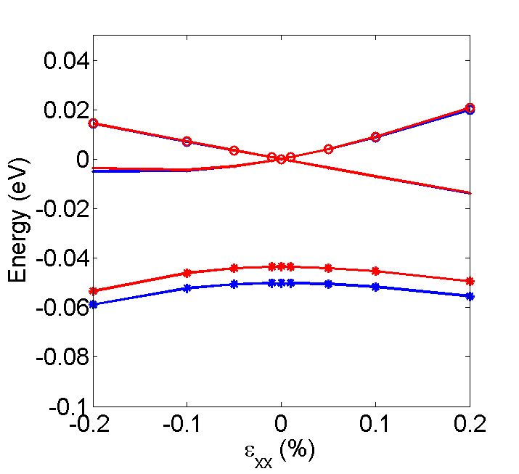
Strained Silicon
biaxial strain ( )
Strain dependent basis functions
Energy of conduction bands under Biaxial strain
Energy of valence bands under Biaxial strain
The behavior of strained Silicon are accurately reproduced!

Slide 12
conclusion
We develop a method Generating TB Parameters from ab-initio simulations
Works for typical semiconductors like Si;
Provides basis functions and TB eigen functions.
Works for new materials like MgO;
Works for more complicated materials like Strained Si.

Slide 13
Thanks!

Slide 14
Si TB Parameters
Parameters | Value | Parameters | Value
E_{s} | 3.3219 | V_{sdσ} | -2.1014
E_{p} | 11.4168 | V_{s*dσ} | -0.3168
E_{s*} | 24.1262 | V_{ppσ} | 3.7130
E_{d} | 24.1313 | V_{ppπ} | -1.4575
∆_{SO} | 0.0183 | V_{pdσ} | -1.9827
V_{ssσ} | -2.0060 | V_{pdπ} | 2.2269
V_{s* s*σ} | -1.9115 | V_{ddσ} | -3.2916
V_{ss*σ} | -0.2093 | V_{ddπ} | 4.0617
V_{spσ} | 2.4967 | V_{ddδ} | -2.2975
V_{s*pσ} | 1.9978

Slide 15
Appendix
Basis functions definition:
TB Bloch functions:
transform matrix U:
basis transformation:

